Slide 1


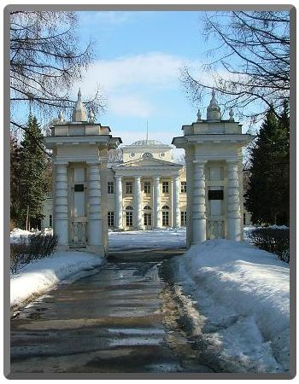
¹²C fragmentation at 0.3-2.0 GeV/n: test of ion-ion interaction models
B.M.Abramov, P.N.Alekseev, Yu.A.Borodin, S.A.Bulychjov, I.A.Dukhovskoy, A.I.Khanov, A.P.Krutenkova, V.V.Kulikov, M.A.Martemyanov, M.A.Matsyuk, E.N.Turdakina
Institute for Theoretical and Experimental Physics, Moscow, Russia
S.G. Mashnik
Los Alamos National Laboratory, New Mexico, USA
64-th International Conference
NUCLEUS 2014
July 1 - 4, 2014 , Minsk, Belarus

Slide 2
Introduction and motivation
Experiment FRAGM at ITEP TWAC (Moscow)
¹²C + Be → f + X
fragments: p, d, t, ³He, ⁴He, ⁶He, ⁸He,…,C
¹²C kinetic energies: T₀ = 0.2 − 3.2 GeV/nucleon
fragment angle: 3.5º with respect to ¹²C direction
different targets: Al, Cu, Ta for ¹²C beam of 0.3 GeV/n
another projectile; ⁵⁶Fe of 0,2 GeV/n and Be target
sensitivity: up to 6 orders of the cross section magnitude
Here we focus mostly on proton fragments
cumulative protons (with velocity higher than that of the projectile) provide
information on localized dense objects (fluctuons) in the projectile nucleus
there is lack of data on cumulative particle production in ion-ion collisions
  test of different models of nucleus-nucleus interactions in a wide kinematic
  region from deep cumulative to mid rapidity region

Slide 3
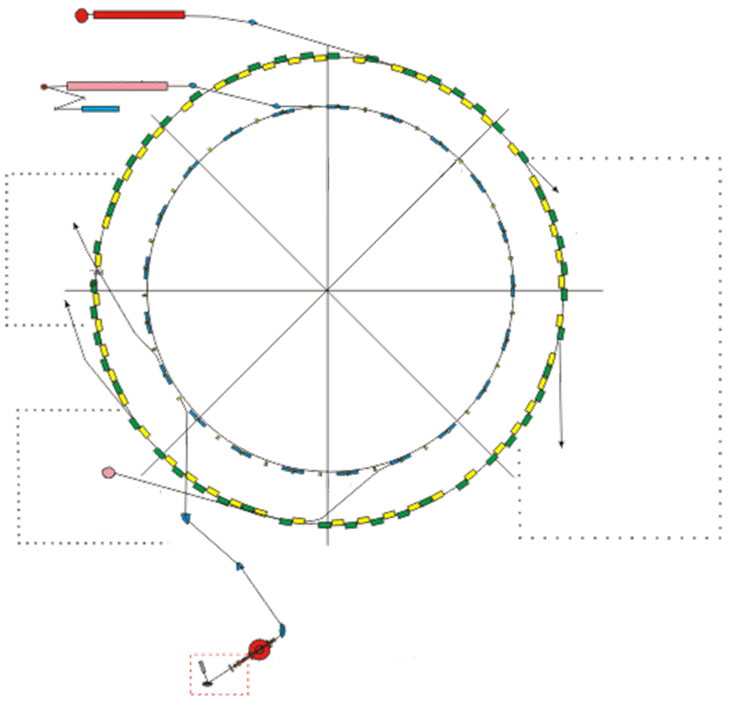
ITEP accelerator complex TWAC
Proton linac I−2, 25 MeV, 200 mA
Main ring
TWAC= TeraWatt Accumulator Complex
Ion linac I−4,
7 MeV/n, 100 mA
Ion laser source
Experimental Hall
Booster synchrotron
20 Hz, 1 GeV/n
TWAC current parameters
Medicine
ion beam
Proton and ion beams from internal target
Proton acceleration :
50 − 10000 MeV
Ion acceleration :
up to 4 GeV/nucleon
Ion accumulation :
up to 700 MeV/nucleon
Accelerating ions :
up to ⁵⁶Fe
Typical intensity :
10¹¹ nucleons / s
Medicine
proton beam
Beamline 313 (FRAGM)
Beams from internal target and slow extraction of protons and ions up to 10 GeV
Fast extraction,
0.7 GeV/n
Multiple injection
Ion beam
injection line
Ion laser source
Ion linac I−3,
1−2 MeV/n

Slide 4
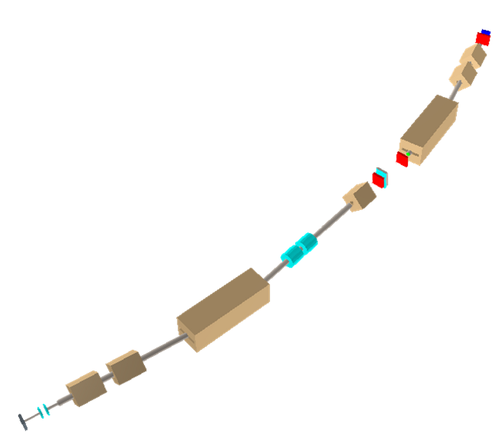




Experiment FRAGM
C3
Beam line spectrometer
C2
Beam line length : 42 m
Two bending magnets : K310C3 (bending
angle : α=0.259 rad.), B313C2 (α=0.276 rad.)
Č
B313I4
B313I3
CF2
B313C2
Five quadrupoles : K310I1,
B313I3 (vertical focusing) and
K310I2, B313B1, B313I4
(horizontal focusing)
H1
CF1
Max.
rigidity
6 GeV
B313B1
Collimators
1m
Scintillation counters for TOF and dE/dx measurement:
CF1, CF2, C2, C3
C2 generates trigger
H1 − hodoscope of 20 elements
Č – Cherenkov counter
K310C3
Monitor 2
3.5⁰
K310I2
Target
K310I1
TWAC main ring
Monitor 1
Notes:
4

Slide 5


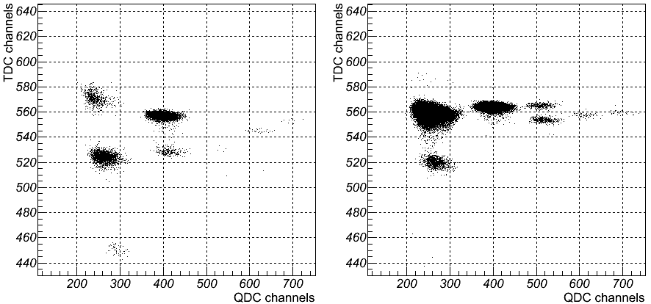
Fragment production in FRAGM
C − Be collisions at 0.95 GeV/nucleon
P beamline / Z = 2.5 GeV/c
P beamline / Z = 3.5 GeV/c
¹H
¹H
³He
²H
⁴He
⁶Li
⁸B
⁹Be
¹¹B
⁷Be
²H
⁴He
⁶Li
³H
⁷Li
³H
QDC channel
QDC channel
Regions of the different fragments are well separated and can be clearly selected

Slide 6
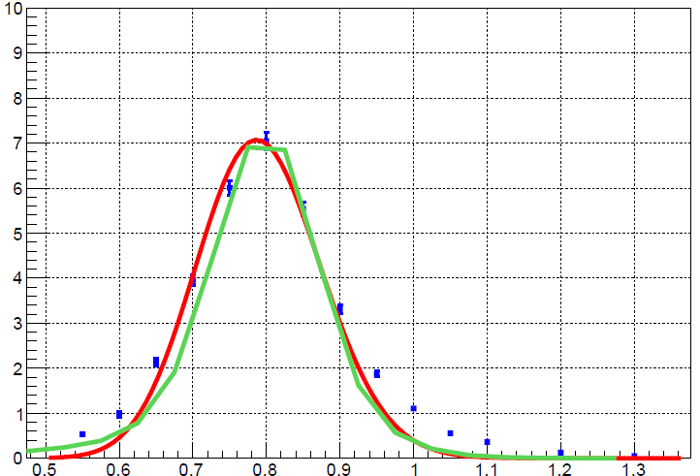
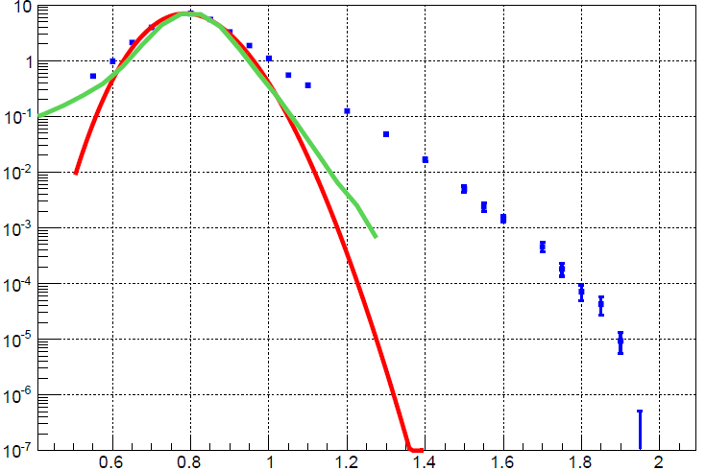
Proton momentum spectrum
Linear scale Log scale
300 MeV/n
SM
QMD
Forbidden
for C+p=p+X
d²Ϭ/dΩdP (a.u.)
Evaporation peak
Cumulative region
Forbidden for p+p=p+X
In inverse kinematics it is easy to measure evaporation protons
even with zero momentum in projectile rest frame to normalize cumulative protons
p, GeV/c

Slide 7
Theoretical interpretation
Nature of cumulative protons is under discussion up to now.
Within appropriate models they can come from :
  highly excited nuclear pre-fragments
  intranuclear multiple scattering
  fluctuations of nuclear matter density
  short-range correlations (SRC) of nucleons
  multiquark clusters
We estimated probabilities of the multiquark clusters in nucleus using approache by A.V.Efremov, A.B.Kaidalov et al. (Phys.At.Nucl. 57,874(1994)) in the framework of quark−gluon string model (QGSM) and
Tested predictions of few models of ion-ion interactions for yield of cumulative protons

Slide 8
Cumulative protons from multiquark clusters
Production of cumulative protons is considered as fragmentation into protons of clusters consisting of 3k quarks (k=1: (3q) − nucleon, k=2: (6q) – two - nucleon cluster, k=3: (9q) – three - nucleon cluster); w_{k} is the probability to find k -nucleon cluster in ¹²C; x = p / p₀ , where p(p₀) – proton (projectile) momentum per nucleon
Ed³σ/d³p(x,p_{t}²) =C’(w₁g(x,p_{t}²)+w₂b₂(x,p_{t}²)+w₃b₃(x,p_{t}²))
g(x,p_{t}²)=G exp(-0.5 (1-x-Δ)² /σ_{x}² ) exp(-0.5 p_{t}²/σ_{p}² )
b₂(x,p_{t}²)=B₂ (x/2)³ (1-x/2)³exp(-α₁ p_{t}²), b₂(x,p_{t}²)=0 at x>2
b₃(x,p_{t}²)=B₃ (x/3)³ (1-x/3)⁶exp(-α₂ p_{t}²), b₃(x,p_{t}²)=0 at x>3
where g, b₂ , b₃ are known fragmentation functions (QGSM).
G, B₂ and B₃ are known normalization constants.
Transverse parameters α₁ and α₂ from Phys.Rev. C 28 (1983) 1224
Fitted variables are: C’, W₂ = w₂/w₁ , W₃ = w₃/w₁ , Δ , σ_{x}

Slide 9
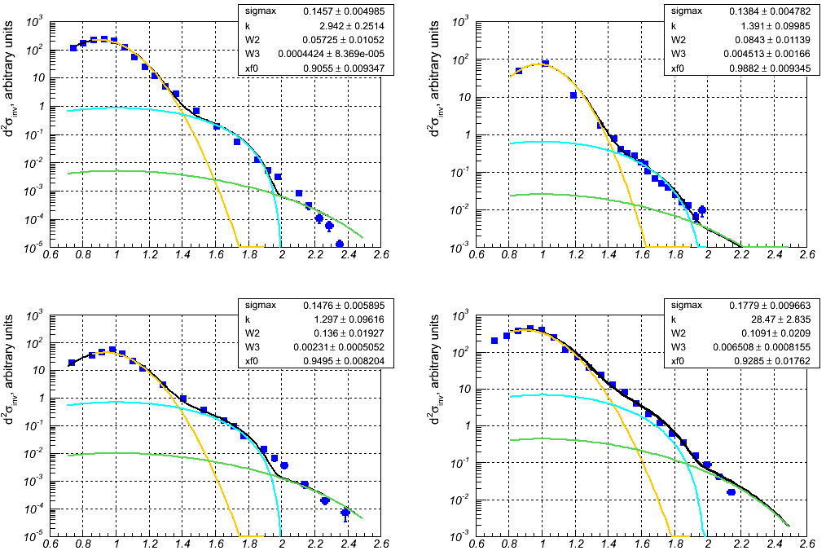
x spectra at different energies
T₀ = 300 MeV/n
T₀ = 600 MeV/n
3q
3q
6q
6q
9q
9q
X
X
T₀ = 950 MeV/n
T₀ = 2.0 GeV/n
3q
3q
6q
6q
9q
9q
X
X

Slide 10
Probabilities of quark clusters
T₀, GeV/n | w₁ (3q) | w₂ (6q) | w₃ (9q)
0.3 | 0.95 | 0.05(1) | 0.0005(1)
0.6 | 0.919 | 0.077(10) | 0.004(2)
0.95 | 0.879 | 0.119(17) | 0.002(1)
2.0 | 0.896 | 0.098(18) | 0.006(1)
Quark cluster probabilities (theor.) | 0.847 | 0.125 0.06 | 0.026
¹²C (e,e’) at J − LAB (E = 4.4 GeV) | − | 0.19(4) | .006(2)
We used fitting procedure to get w₂ and w₃
M. Sato et al (1986)
V.Burov et al (1977),
pions, fluctuon
K.S. Egiyan et al (2006)
For the first time the quantitative estimation on few nucleon clusters in nuclei was obtained from fragmentation data
Wider range on x and wider projectile energy range are desirable

Slide 11
Test of four models of ion-ion interactions
QMD – Quantum Molecular Dynamics (Geant4 package).
BC – Binary Cascade model (Geant4 package).
LAQGSM – Los Alamos Quark Gluon String Model
by courtesy of Stepan Mashnik (LA-UR-11-01887),
SHIELD-HIT code with MSDM (Multi Stage Dynamic Model) by courtesy of Nikolay Sobolevsky (www.inr.ru/shield).
100M of simulated interactions are needed to have a reasonable comparison with our data. It is a serious computational problem.

Slide 12
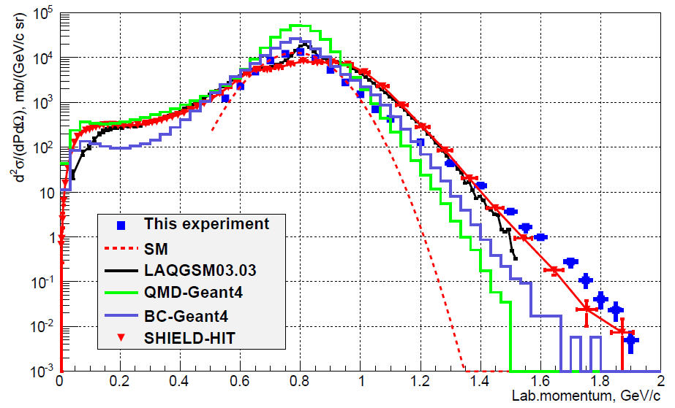
Protons from C+Be→p+X at 3.5⁰
300 MeV/n

Slide 13
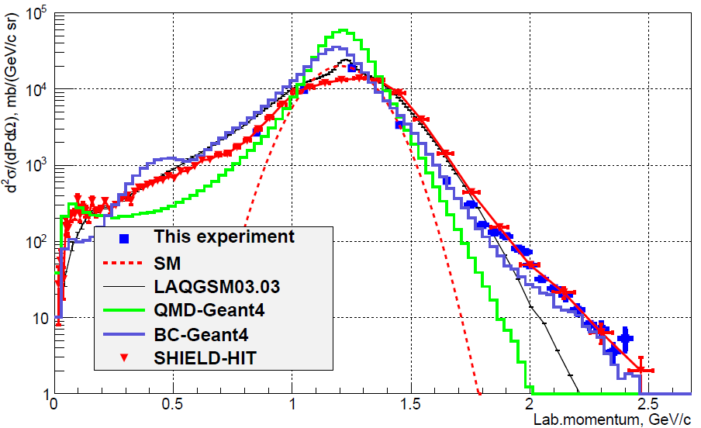
Protons from C+Be→p+X at 3.5⁰
600 MeV/n

Slide 14
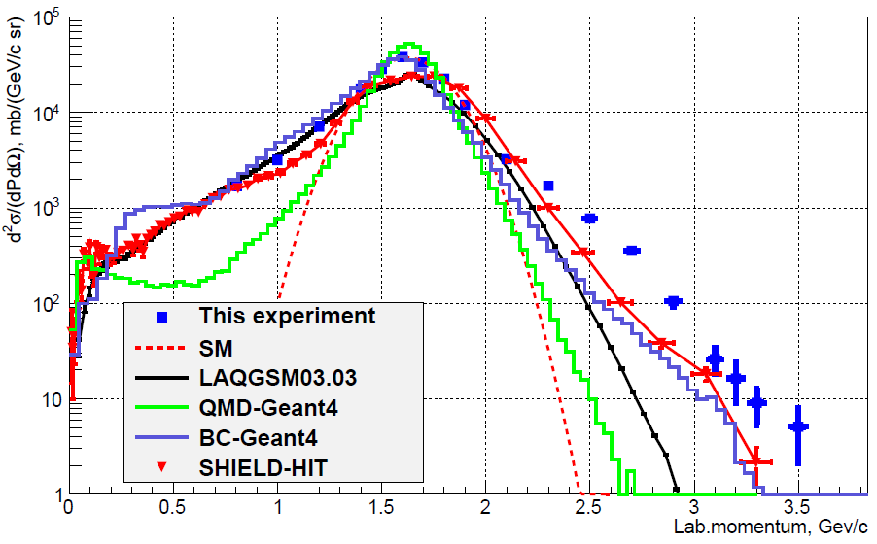
Protons from C+Be→p+X at 3.5⁰
950 MeV/n

Slide 15
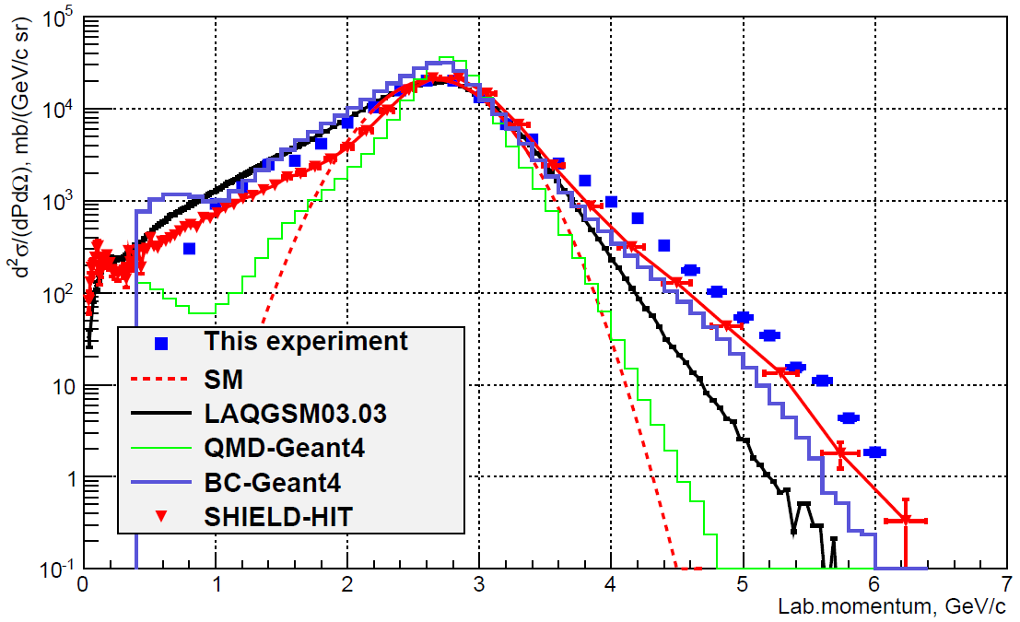
Protons from C+Be→p+X at 3.5⁰
2000 MeV/n

Slide 16
Short summary
r.m.s. (MeV/c) of fragmentation peak near max.
T Exp. BC QMD LAQGSM SHIELD
300 91±5 81 75 113* 130*
600 130±7 126 100 172* 243*
950 165±12 147 121 217* 270
2000 352±38 270 207 384 337
Dif.cross section (mb/GeV/c/sr) at P =2P0
T Exp. BC QMD LAQGSM SHIELD
300 1.7±0.2 .02 .003 .009 .44
600 5.3±0.7 1.8 .002 .11 3.8±1.3
950 29.2±3.1 1.2 .0065 .07 5.1±3.1
2000 24.3±1.6 4.2 .002 .29 9.9±2.8

Slide 17
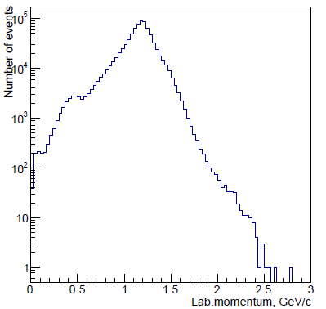
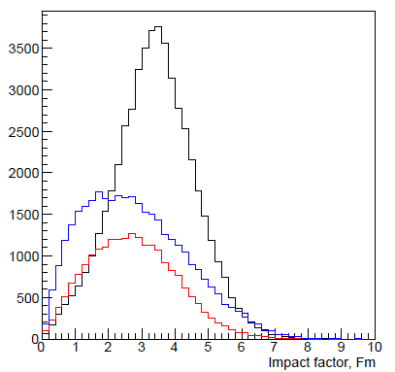
Proton momentum spectrum vs impact factor in BC
C
q- impact factor
q
Be
600 MeV/n
R_{C} +R_{Be}
Fragmentation maximum results from peripheral interactions, cumulative and mid-rapidity regions are more central.

Slide 18
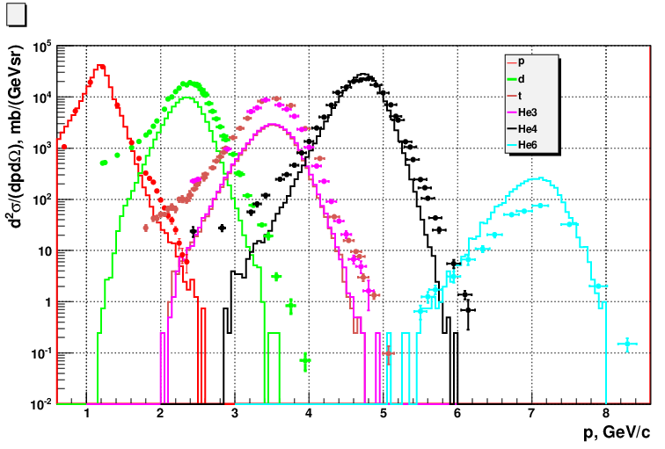
Relative yields of H and He isotopes: data vs BC
Data are normalized to BC for protons at fragmentation maximum,
Data – points, BC - histograms
p
d
t,He-3
He-4
He-6
0.6 GeV/n
Lab. Momentum
Shape of fragmentations peak near its maximum are reasonably described by BC,
relative agreement is fine for He-4, and better than 3 times for the rest isotopes.

Slide 19
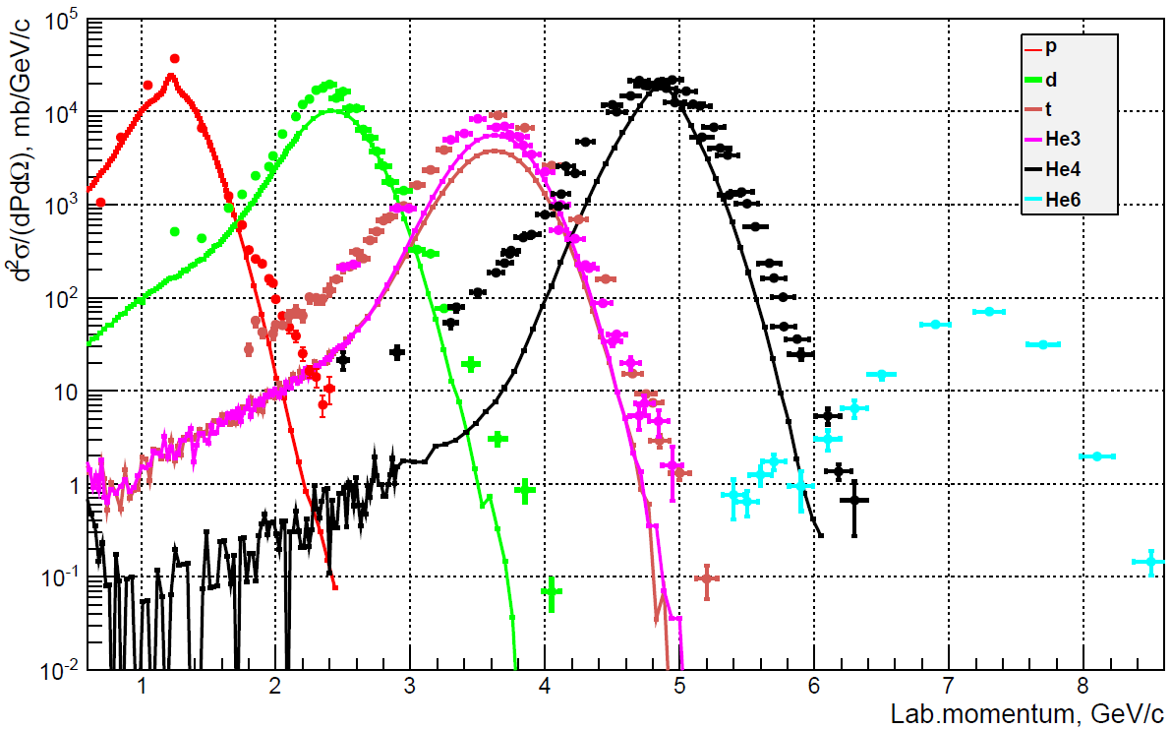
Yields of H and He isotopes: data vs LAQGSM
Data are normalized to BC for protons at fragmentation maximum,
Data – points, LAQGSM - lines
p
d
t,He-3
He-4
He-6
0.6 GeV/n
Shape of fragmentation peaks for p and d are reasonably described by LAQGSM,
for t,He-3,He-4 peaks are narrower, relative maximum values are predicted well,
mid-rapidity region for A>2 is underestimated.

Slide 20
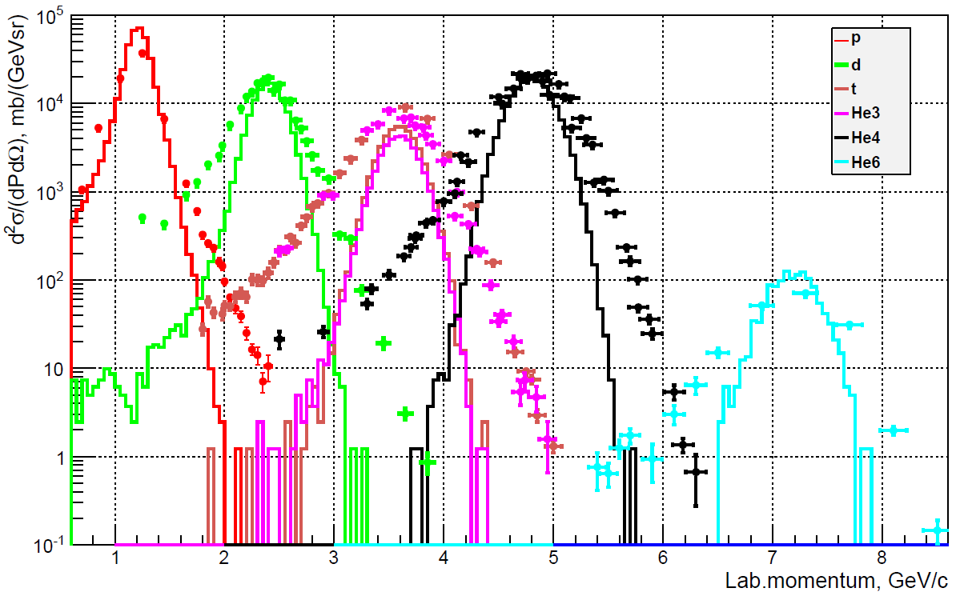
Yields of H and He isotopes: data vs QMD
Data are normalized to BC for protons at fragmentation maximum,
Data – points, QMD - histograms
p
d
t,He-3
He-4
He-6
  0.6 GeV/n
Shape of fragmentation peaks (apart from p) are too narrow, but relative maximum
values are predicted well. Mid-rapidity region for A>1 is strongly underestimated.

Slide 21
Conclusion
Proton momentum spectra from ¹²C fragmentation have been analyzed in two approaches.
1) Multi-quark cluster model with fragmentation functions calculated in QGSM gives reasonable description of cumulative proton spectra in wide energy range. This analysis have been published in JETP Lett. 97 (2013) 439
2) Predictions of four models of ion-ion interactions (QMD, BC, LAQGSM, SHIELD-HIT) have been compared to the data. In the region of fragmentation peak all models give reasonable description of the data but in high momentum region they differ from each other up to few orders of magnitude. Best description of the data in this region gives SHIELD-HIT and BC. Production of H and He isotopes have been compared to the data.

Slide 22
Thank You
Notes:
22

